Slide 1
Intermediate Coding Week 22
Sets and Maps

Slide 2

Sets
Notes:
Skip if it’s already past 4:35.

Slide 3
Set implementation
in Java, sets are represented by Set interface in java.util
Set is implemented by HashSet and TreeSet classes
HashSet: implemented using a "hash table" array; very fast: O(1) for all operations elements are stored in unpredictable order
TreeSet: implemented using a binary search tree; pretty fast: O(log N) for all operations elements are stored in sorted order

Slide 4
Set methods
List<String> list = new ArrayList<String>();
...
Set<Integer> set = new TreeSet<Integer>(); // empty
Set<String> set2 = new HashSet<String>(list);
can construct an empty set, or one based on a given collection
add(value) | adds the given value to the set
contains(value) | returns true if the given value is found in this set
remove(value) | removes the given value from the set
clear() | removes all elements of the set
size() | returns the number of elements in list
isEmpty() | returns true if the set's size is 0
toString() | returns a string such as "[3, 42, -7, 15]"

Slide 5
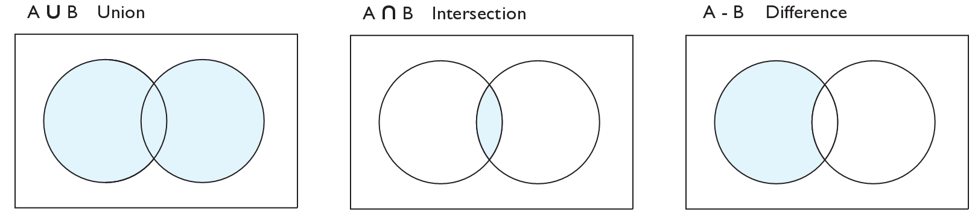
Set operations
addAll
retainAll
removeAll
addAll(collection) | adds all elements from the given collection to this set
containsAll(coll) | returns true if this set contains every element from given set
equals(set) | returns true if given other set contains the same elements
iterator() | returns an object used to examine set's contents (seen later)
removeAll(coll) | removes all elements in the given collection from this set
retainAll(coll) | removes elements not found in given collection from this set
toArray() | returns an array of the elements in this set

Slide 6
Sets and ordering
HashSet : elements are stored in an unpredictable order
Set<String> fruits = new HashSet<String>();
names.add(“Banana");
names.add(“Apple");
names.add(“Durian");
names.add(“Cherry");
System.out.println(fruits);
// [Apple, Cherry, Durian, Banana]
TreeSet : elements are stored in their "natural" sorted order
Set<String> fruits = new TreeSet<String>();
...
// [Apple, Banana, Cherry, Durian]

Slide 7
The "for each" loop (7.1)
for (type name : collection) {
statements;
}
Provides a clean syntax for looping over the elements of a Set, List, array, or other collection
Set<Integer> mySet = new HashSet<Integer>();
...
for (int num : mySet) {
System.out.println(num);
}
needed because sets have no indexes; can't get element i

Slide 8
Maps
Notes:
Skip if it’s already past 4:35.

Slide 9
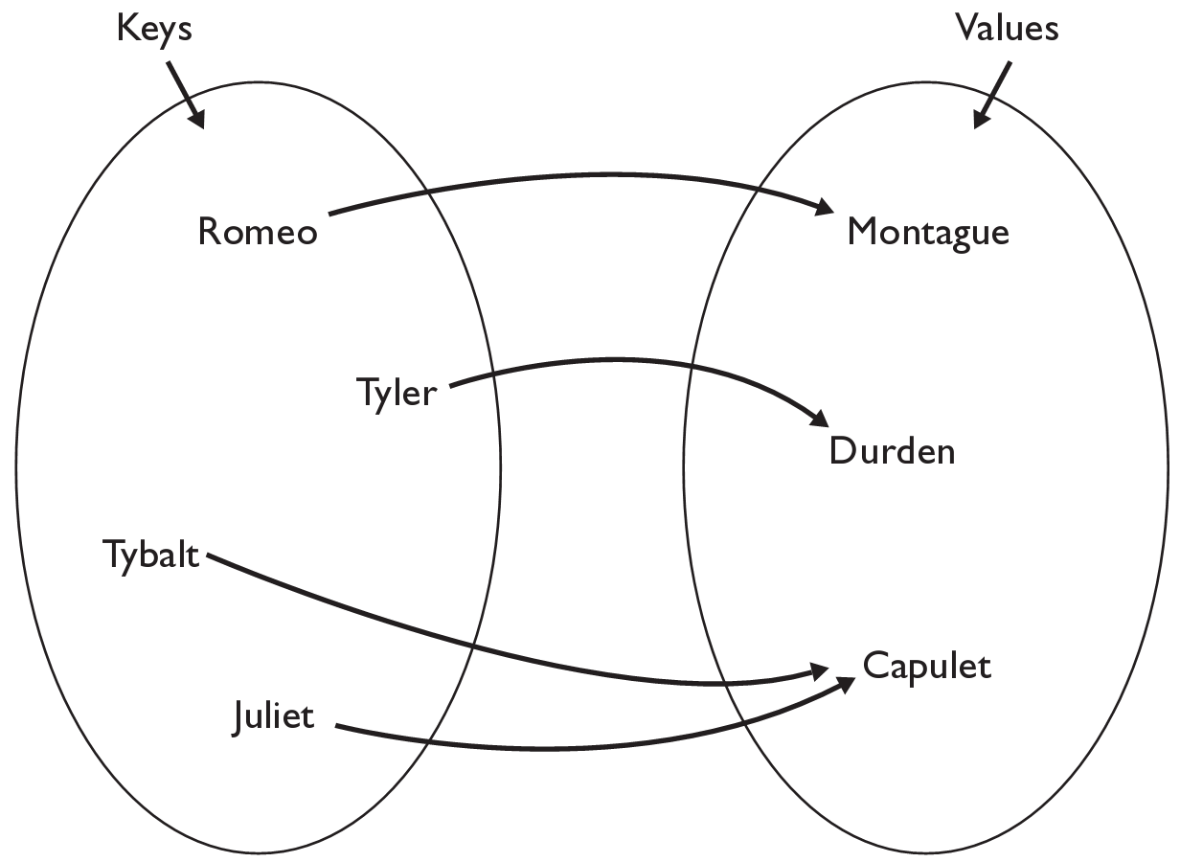
Java Maps
map: Holds a set of unique keys and a collection of values, where each key is associated with one value.
a.k.a. "dictionary"
basic map operations:
put(key, value ): Adds a mapping from a key to a value.
get(key ): Retrieves the value mapped to the key.
remove(key ): Removes the given key and its mapped value.
myMap.get("Juliet") returns "Capulet"

Slide 10
Map implementation
in Java, maps are represented by Map interface in java.util
Map is implemented by the HashMap and TreeMap classes
HashMap: implemented using an array called a "hash table"; extremely fast: O(1) ; keys are stored in unpredictable order
TreeMap: implemented as a linked binary tree structure; very fast: O(log N) ; keys are stored in sorted order
A map requires 2 type parameters: one for keys, one for values.
// maps from String keys to Integer values
Map<String, Integer> votes = new HashMap<String, Integer>();

Slide 11
Map methods
put(key, value) | adds a mapping from the given key to the given value; if the key already exists, replaces its value with the given one
get(key) | returns the value mapped to the given key (null if not found)
containsKey(key) | returns true if the map contains a mapping for the given key
remove(key) | removes any existing mapping for the given key
clear() | removes all key/value pairs from the map
size() | returns the number of key/value pairs in the map
isEmpty() | returns true if the map's size is 0
toString() | returns a string such as "{a=90, d=60, c=70}"
keySet() | returns a set of all keys in the map
values() | returns a collection of all values in the map
putAll(map) | adds all key/value pairs from the given map to this map
equals(map) | returns true if given map has the same mappings as this one

Slide 12
Using maps
A map allows you to get from one half of a pair to the other.
Remembers one piece of information about every index (key).
Later, we can supply only the key and get back the related value:
Allows us to ask: What is Romeo’s last name?
// key value
put(“Romeo", “Montague")
Map
get(“Romeo")
Map
“Montague"

Slide 13
keySet
keySet method returns a Set of all keys in the map
can loop over the keys in a foreach loop
can get each key's associated value by calling get on the map
Map<String, Integer> ages = new TreeMap<String, Integer>();
ages.put("Marty", 19);
ages.put("Geneva", 2); // ages.keySet() returns Set<String>
ages.put("Vicki", 57);
for (String name : ages.keySet()) { // Geneva -> 2
int age = ages.get(age); // Marty -> 19
System.out.println(name + " -> " + age); // Vicki -> 57
}

Slide 14

Problems

Slide 15
Question 1
Write a program that removes the elements “a” and “b” from a set (you can choose whether to use TreeSet or HashSet) if they are both in the set.
Examples:
{“a”, “b”, “c”}, should be modified to {“c”}.
{“a”, “c”, “d”}, should stay unchanged.
{“b”, “c”, “d”}, should stay unchanged.
{“c”, “d”}, should stay unchanged.

Slide 16
Question 2
Write a program that checks if the keys “a” and “b” are present in a map from strings to strings (you can choose whether to use TreeMap or HashMap) and if they are both present, appends their values together and stores the result under the key “ab”.
Examples:
{“a”: “Hello”, “b”: “World”} should be modified to {“a”: “Hello”, “ab”: “HelloWorld”, “b”: “World”}
{“a”: “Hello”} should stay unchanged.
{“b”: “World”} should stay unchanged.

Slide 17
Question 3
Write a method that given an array of strings, returns a Map<String, Integer> with a key for each different string, and the value of the number of times that string appears in the array.
Examples:
[“a”, “b”, “a”, “c”, “b”] should return {“a”: 2, “b”: 2, “c”: 1}
[“shirt”, “jacket”, “pants”] should return {“shirt”: 1, “jacket”: 1, “pants”: 1}
[“carrot”, “carrot”, “carrot”, “carrot”] should return {“carrot”: 4}

